Slide 1
Natural Language Processing (NLP)
with Deep NLP
from Zero to Hero
FAHAD HUSSAIN
MCS, MSCS, DAE(CIT)
Computer Science Instructor of well known international Center
Also, Machine Learning and Deep learning Practitioner
For further assistance, code and slide https://fahadhussaincs.blogspot.com/
YouTube Channel: https://www.youtube.com/channel/UCapJpINJKHzflWwCQ8Kse2g/playlists

Slide 2
Prerequisite
for
Natural language processing
Python
Basic Concept of Machine Learning and Deep Learning

Slide 3
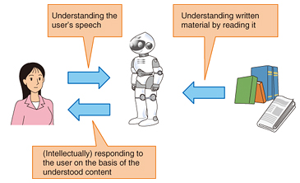
Natural language processing

Slide 4
Natural language processing
Natural language processing (NLP) is a subfield of linguistics, computer science, information engineering, and artificial intelligence concerned with the interactions between computers and human (natural) languages, in particular how to program computers to process and analyze large amounts of natural language data.
Challenges in natural language processing frequently involve speech recognition, natural language understanding, and natural language generation.
Fahad Hussain Tutorial
Fahad Hussain Tutorial
Fahad Hussain Tutorial
For further assistance, code and slide https://fahadhussaincs.blogspot.com/
YouTube Channel: https://www.youtube.com/channel/UCapJpINJKHzflWwCQ8Kse2g/playlists

Slide 5
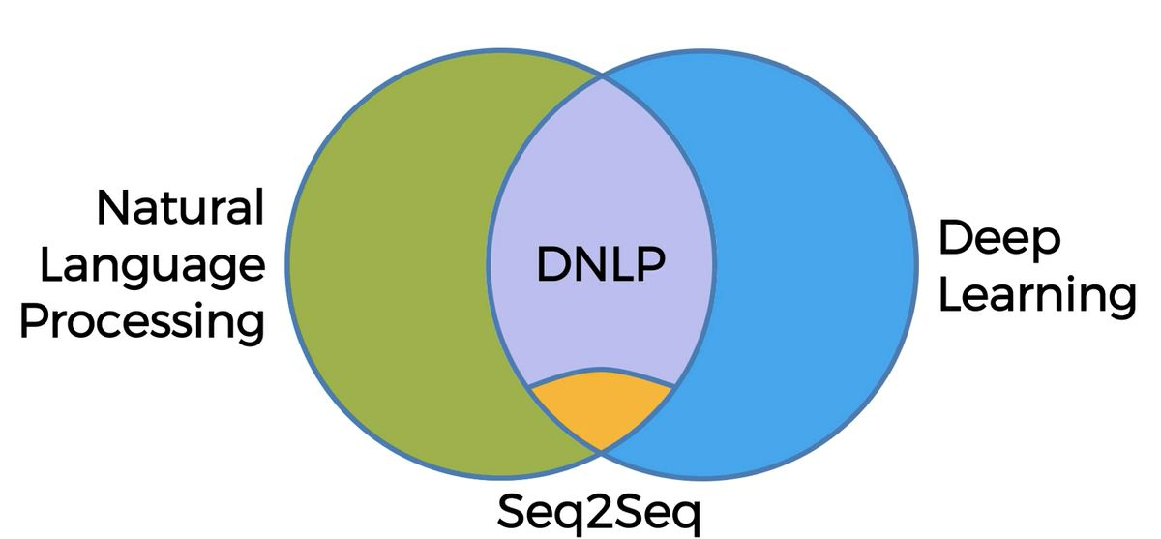
Types of NLP
Fahad Hussain Tutorial
Fahad Hussain Tutorial
Fahad Hussain Tutorial
For further assistance, code and slide https://fahadhussaincs.blogspot.com/
YouTube Channel: https://www.youtube.com/channel/UCapJpINJKHzflWwCQ8Kse2g/playlists

Slide 6
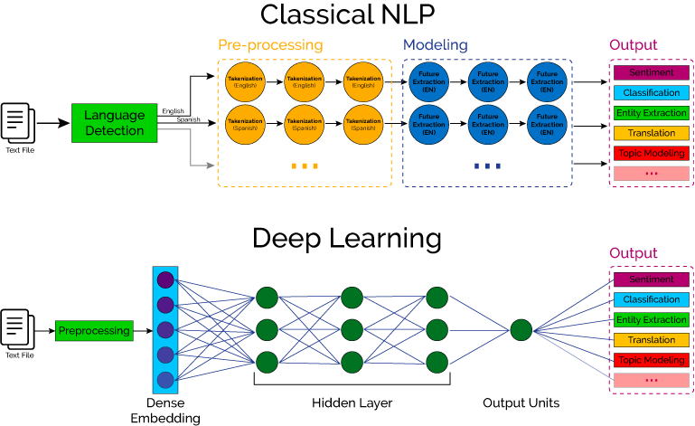

Slide 7
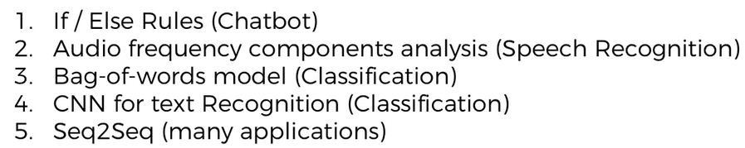
How NLP, DNLP and DL involves in!!!
Fahad Hussain Tutorial
Fahad Hussain Tutorial
Fahad Hussain Tutorial
For further assistance, code and slide https://fahadhussaincs.blogspot.com/
YouTube Channel: https://www.youtube.com/channel/UCapJpINJKHzflWwCQ8Kse2g/playlists

Slide 8
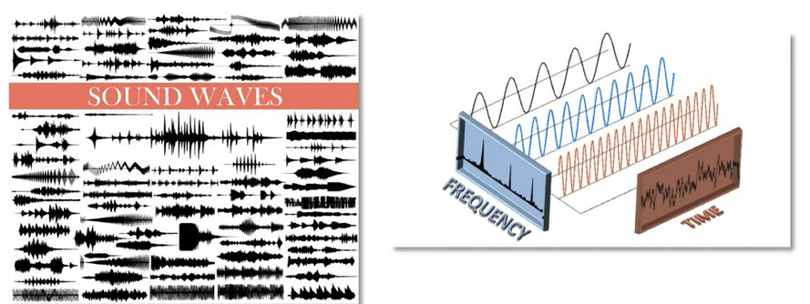
How NLP, DNLP and DL involves in!!!
Fahad Hussain Tutorial
Fahad Hussain Tutorial
Fahad Hussain Tutorial
For further assistance, code and slide https://fahadhussaincs.blogspot.com/
YouTube Channel: https://www.youtube.com/channel/UCapJpINJKHzflWwCQ8Kse2g/playlists

Slide 9
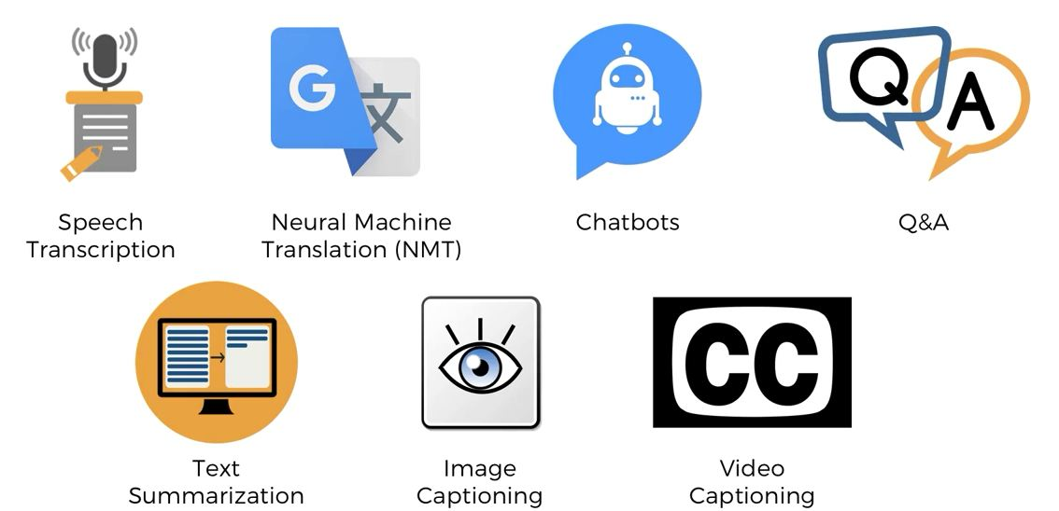
Applications
Fahad Hussain Tutorial
Fahad Hussain Tutorial
Fahad Hussain Tutorial
For further assistance, code and slide https://fahadhussaincs.blogspot.com/
YouTube Channel: https://www.youtube.com/channel/UCapJpINJKHzflWwCQ8Kse2g/playlists

Slide 10
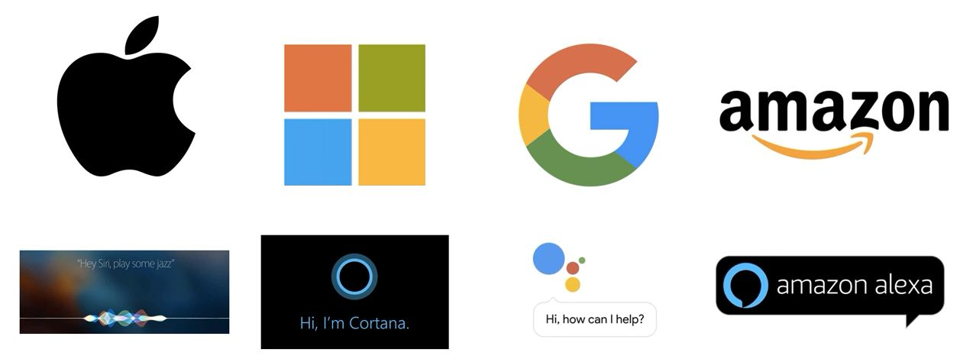
Used by
Fahad Hussain Tutorial
Fahad Hussain Tutorial
Fahad Hussain Tutorial
For further assistance, code and slide https://fahadhussaincs.blogspot.com/
YouTube Channel: https://www.youtube.com/channel/UCapJpINJKHzflWwCQ8Kse2g/playlists

Slide 11
Thanks
Do Subscribe, like and share
next we will discuss about
How NLP work?
For further assistance, code and slide https://fahadhussaincs.blogspot.com/
YouTube Channel: https://www.youtube.com/channel/UCapJpINJKHzflWwCQ8Kse2g/playlists

Slide 12
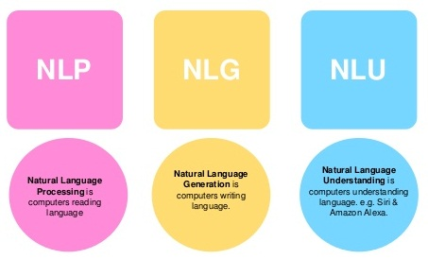
NLP Working
Fahad Hussain Tutorial
Fahad Hussain Tutorial
For further assistance, code and slide https://fahadhussaincs.blogspot.com/
YouTube Channel: https://www.youtube.com/channel/UCapJpINJKHzflWwCQ8Kse2g/playlists

Slide 13
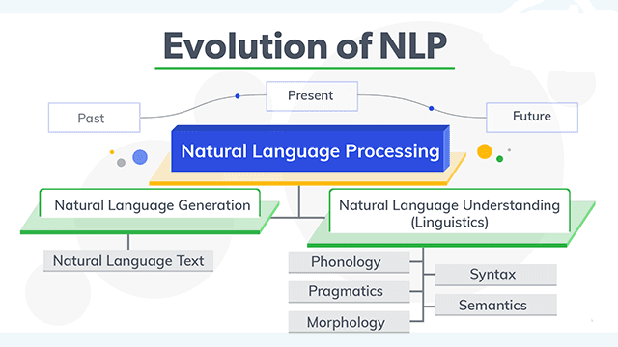
NLP Working
Fahad Hussain Tutorial
Fahad Hussain Tutorial
Fahad Hussain Tutorial
For further assistance, code and slide https://fahadhussaincs.blogspot.com/
YouTube Channel: https://www.youtube.com/channel/UCapJpINJKHzflWwCQ8Kse2g/playlists

Slide 14
Natural Language Understanding
Ambiguity:
Lexical Ambiguity : The Tank is full of water.
Syntactic Ambiguity : ill men and women get to hospital.
Semantic Ambiguity : The Bike hit the pole while it was running.
Pragmatic Ambiguity : The Army is coming.
Phonology – This science helps to deal with patterns present in the sound and speeches related to the sound as a physical entity.
Pragmatics – This science studies the different uses of language.
Morphology – This science deals with the structure of the words and the systematic relations between them.
Syntax – This science deal with the structure of the sentences.
Semantics – This science deals with the literal meaning of the words, phrases as well as sentences.
For further assistance, code and slide https://fahadhussaincs.blogspot.com/
YouTube Channel: https://www.youtube.com/channel/UCapJpINJKHzflWwCQ8Kse2g/playlists

Slide 15
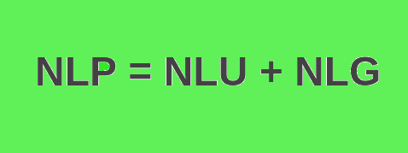
Natural Language Generation
Based on NL-Understanding, it will suggest about:
What should say to user.
Should be Intelligent and Covervational as like human
Usage of Structured data.
With text and Sentence like planning.
Fahad Hussain Tutorial
Fahad Hussain Tutorial
Fahad Hussain Tutorial
For further assistance, code and slide https://fahadhussaincs.blogspot.com/
YouTube Channel: https://www.youtube.com/channel/UCapJpINJKHzflWwCQ8Kse2g/playlists

Slide 16
Thanks
Do Subscribe, like and share
next we will discuss about
Data Processes,
Tokenization?
For further assistance, code and slide https://fahadhussaincs.blogspot.com/
YouTube Channel: https://www.youtube.com/channel/UCapJpINJKHzflWwCQ8Kse2g/playlists

Slide 18
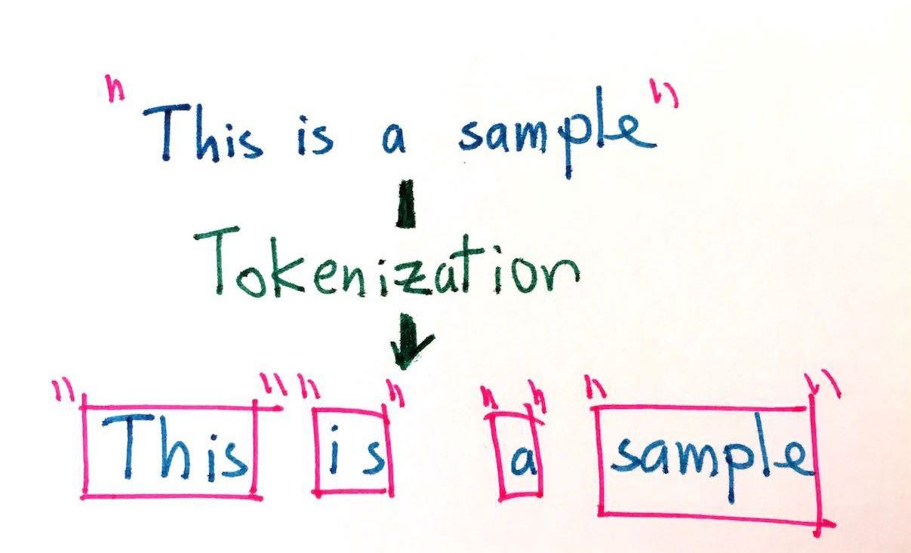
Tokenization
Tokenization is the process of replacing sensitive data with unique identification symbols that retain all the essential information about the data without compromising its security.
Fahad Hussain Tutorial
Fahad Hussain Tutorial
Fahad Hussain Tutorial
For further assistance, code and slide https://fahadhussaincs.blogspot.com/
YouTube Channel: https://www.youtube.com/channel/UCapJpINJKHzflWwCQ8Kse2g/playlists

Slide 19
Tokenization
There are many library / framework for NLP problem solution
1. Natural Language Toolkit (NLTK)
2. TextBlob
3. CoreNLP
4. Gensim
5. spaCy
6. polyglot
7. scikit–learn
8. Pattern
Fahad Hussain Tutorial
Fahad Hussain Tutorial
Fahad Hussain Tutorial
So lets' move to COLAB for practical work...
For further assistance, code and slide https://fahadhussaincs.blogspot.com/
YouTube Channel: https://www.youtube.com/channel/UCapJpINJKHzflWwCQ8Kse2g/playlists

Slide 20
Stemming and Lemmatization
Before understanding Stemming and Lemmatization, first let’s understand the following…
Prefix: Character(s) at the beginning ▸ $ ( “ ¿
Suffix: Character(s) at the end ▸ km ) , . ! ”
Infix: Character(s) in between ▸ - -- / ...
Exception: Special-case rule to split a string into several tokens or prevent a token from being split when punctuation rules are applied St. U.S.
Fahad Hussain Tutorial
For further assistance, code and slide https://fahadhussaincs.blogspot.com/
YouTube Channel: https://www.youtube.com/channel/UCapJpINJKHzflWwCQ8Kse2g/playlists

Slide 21
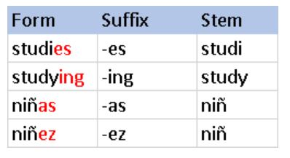

Stemming
Stemming is the process of reducing a word to its word stem that affixes to suffixes and prefixes or to the roots of words known as a lemma. Stemming is important in natural language understanding (NLU) and natural language processing (NLP).
Fahad Hussain Tutorial
For further assistance, code and slide https://fahadhussaincs.blogspot.com/
YouTube Channel: https://www.youtube.com/channel/UCapJpINJKHzflWwCQ8Kse2g/playlists

Slide 22
Porter Stemming
One of the most common - and effective - stemming tools is Porter's Algorithm developed by Martin Porter in 1980. The algorithm employs five phases of word reduction, each with its own set of mapping rules
e.g: caresses reduces to caress but not cares
Fahad Hussain Tutorial
For further assistance, code and slide https://fahadhussaincs.blogspot.com/
YouTube Channel: https://www.youtube.com/channel/UCapJpINJKHzflWwCQ8Kse2g/playlists

Slide 23
Snowball Stemming
Snowball is a small string processing language designed for creating stemming algorithms for use in Information Retrieval. This site describes Snowball, and presents several useful stemmers which have been implemented using it
Fahad Hussain Tutorial
Useful link for additional reading...
https://nlp.stanford.edu/IR-book/html/htmledition/stemming-and-lemmatization-1.html
For further assistance, code and slide https://fahadhussaincs.blogspot.com/
YouTube Channel: https://www.youtube.com/channel/UCapJpINJKHzflWwCQ8Kse2g/playlists

Slide 24
Thanks
Do Subscribe, like and share
next we will discuss about
Next Topic,
Lemmatization?
For further assistance, code and slide https://fahadhussaincs.blogspot.com/
YouTube Channel: https://www.youtube.com/channel/UCapJpINJKHzflWwCQ8Kse2g/playlists

Slide 25
Lemmatization
Lemmatization usually refers to doing things properly with the use of a vocabulary and morphological analysis of words, normally aiming to remove inflectional endings only and to return the base or dictionary form of a word, which is known as the lemma .
Fahad Hussain Tutorial
The lemma of 'was' is 'be' and the lemma of 'mice' is 'mouse’.
Further, the lemma of 'meeting' might be 'meet' or 'meeting’
depending on its use in a sentence.
For further assistance, code and slide https://fahadhussaincs.blogspot.com/
YouTube Channel: https://www.youtube.com/channel/UCapJpINJKHzflWwCQ8Kse2g/playlists

Slide 26
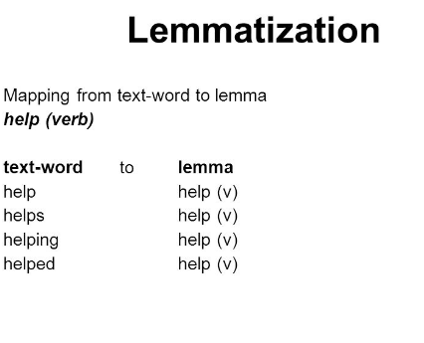
Lemmatization
https://nlp.stanford.edu/IR-book/html/htmledition/stemming-and-lemmatization-1.html
For further assistance, code and slide https://fahadhussaincs.blogspot.com/
YouTube Channel: https://www.youtube.com/channel/UCapJpINJKHzflWwCQ8Kse2g/playlists

